Slide 1
GIS Output

Slide 2
The output of GIS is presented in form of a hardcopy map or digital visualization.
All the works done in GIS is only successful if the maps/visualization can provide the right message to the audience.
A message to one type of audience could be noise to other type of audience.

Slide 3
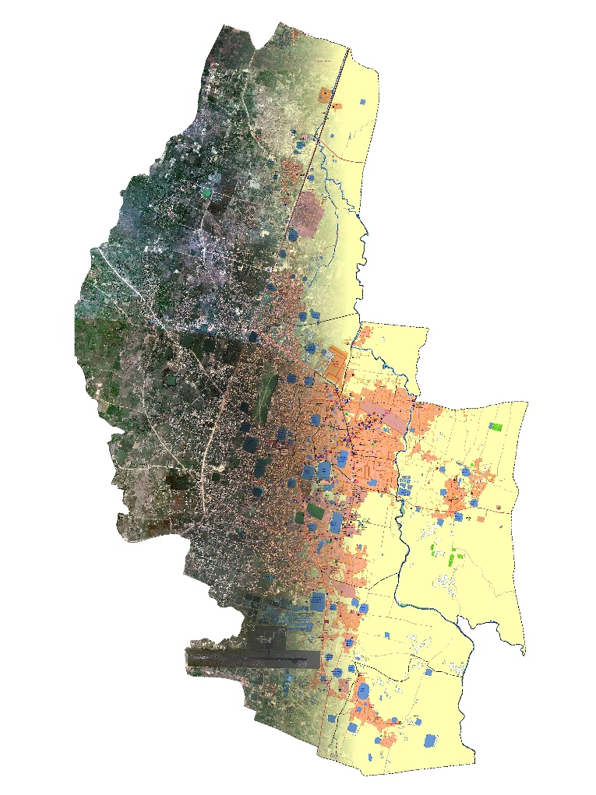
Map
Ground Reality
The reduced and generalized, in a scientific way, representation of the whole or part of the Earth onto a flat medium (generally but not necessarily in a paper) is called a map.
Representation of Reality (Map)

Slide 4
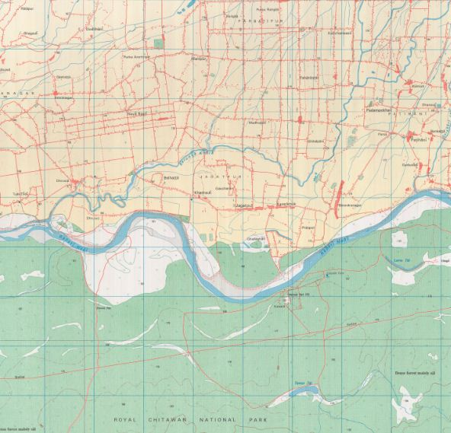
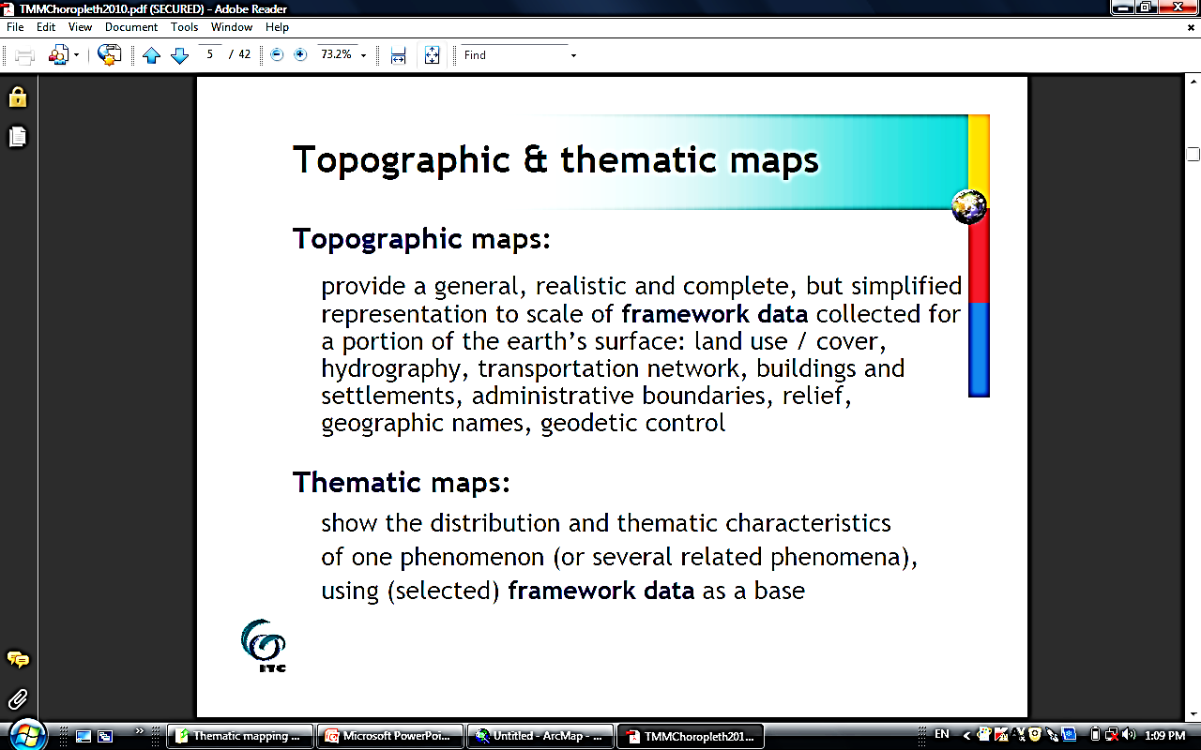
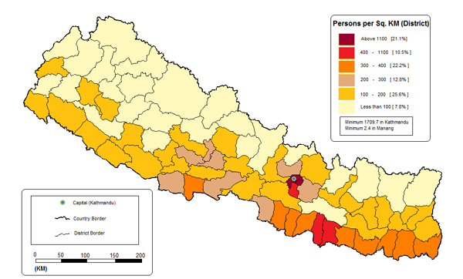
Types

Slide 5
Steps of GIS
Data collection
Data Input
Data Management
Data Analysis
Data Dissemination

Slide 6

Overall Process in Map Communication
Cartographer
GIS/CAD specialist
Reality….
The geographic
environment
Recognize
Select
Compile
Classify
Simplify
Symbolize
Map User
Map
Mental
image
of reality
Map
Map
Image
Read
Analyze
Interpret

Slide 7
Spatial data visualization
Visualization is considered as the translation or conversion of spatial data from a database into graphics.
GIS as a visualization tool, are most effective in communicating spatial data, whether the emphasis is on the location or the distribution of the spatial pattern.
Mostly the end results are generated as soft copy products on the screen of the computer monitor, dynamic visualization via internet on the web or hard copy paper map using a printer or plotter.

Slide 8
GIS output is most often in the form of a map, and as such, can benefit from principles of cartographic design developed in cartography regarding:
Graphical excellence
Principles of map design
Remember –”Computers do not make good or bad maps – cartographers do!”

Slide 9
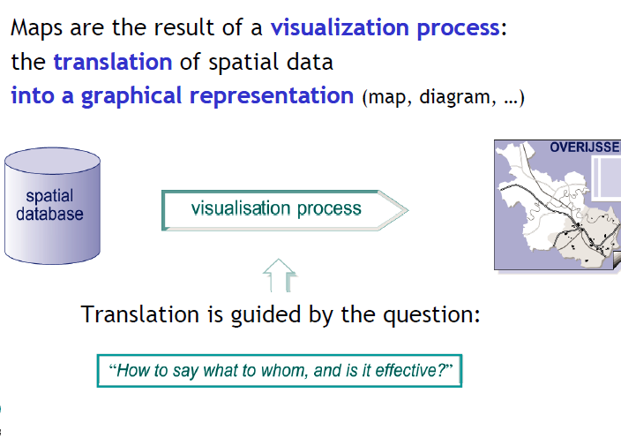
Spatial data visualization

Slide 10
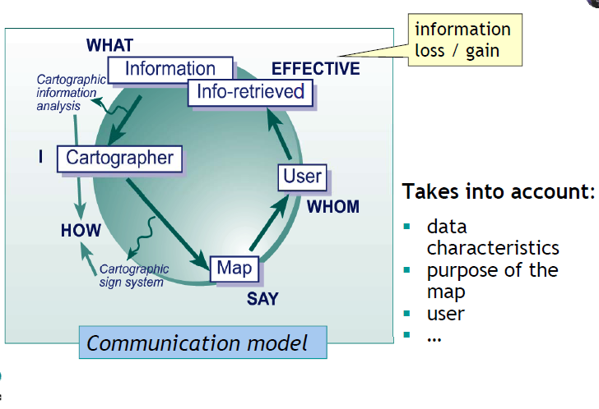
How to say what to whom and is it effective?

Slide 11
Map design

Slide 12
Map design
Map design is a visual plan to achieve a goal. The purpose of a map design is to enhance map communication.
A well designed map is balanced and interesting to look and can help to communicate the spatial information to the map reader, where as a poorly designed map can confuse the map reader and even distort the information intended by the map maker.

Slide 13
Factors to consider in Map design
The map designer must design a map that must be simple, appropriateness and pleasing appearance and should consider the following issues carefully;
Why are you making map? Prior to making a map, clarify your purpose. The purpose determines what features are included and how they are represented.
Who are your map audience? The map designer and the map user mostly will be different people, and the map user is not necessarily familiar with the information in the GIS - “the data behind the maps.” Knowing the intended audience for your map will help you design it.

Slide 14
Factors to consider in Map design
What is the final medium of your map? The final form of your map –paper, computer monitor (projector), or web will affect its design.
Evaluate your map: Evaluation plays a useful role in making maps.

Slide 15
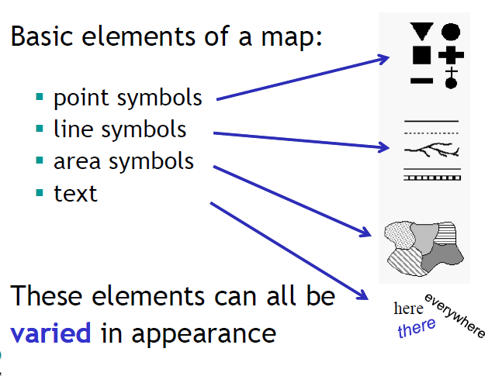
Basic Spatial components

Slide 16
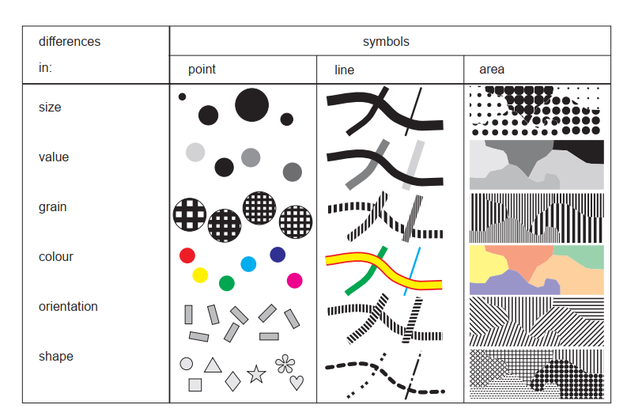
Bertin’s visual variables (1967)

Slide 17
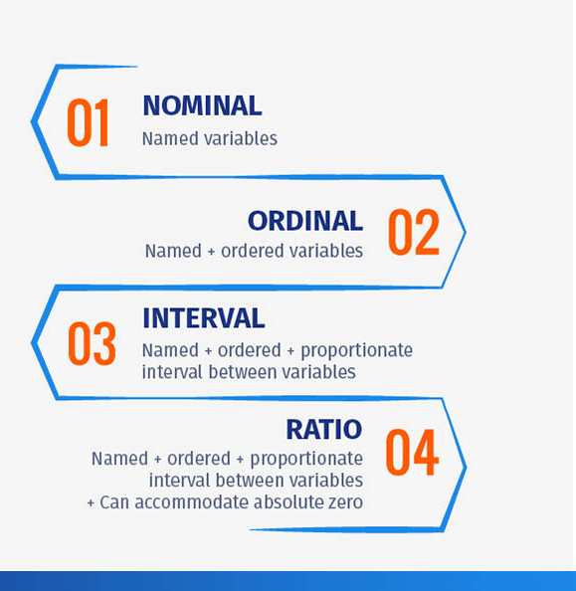
Measurement Scales
Measurement Scale | Examples
Nominal | Individual place Locations (Biratnagar, Dharan, Kathmandu)
Ordinal | Road types (Highway, District, Local)
Interval | Temperature
Ratio | Population

Slide 18
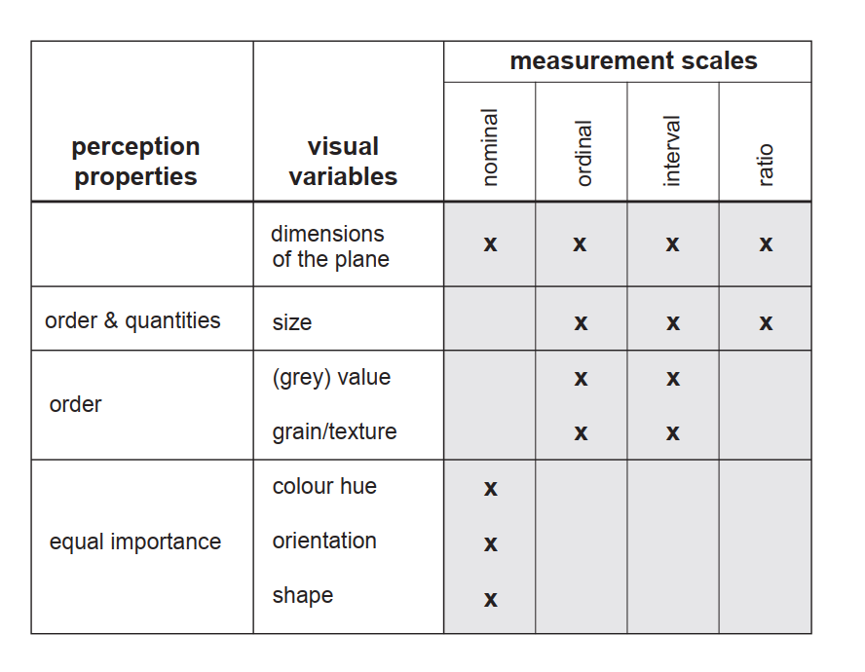
Perception properties and visual variables
Notes:
Attribute values of features are either qualitative or quantitative. Data scales are:
nominal: Qualitative attribute values are different in nature, without one aspect being more important than another (e.g. forms of land use).
ordinal: Qualitative attribute values are different from each other, but there is one singleway to order them, as some are more important/intense than others (e.g. importance of roads).
interval: Quantitative attribute values are different and can be ordered. The distance between individual measurements can be determined (e.g. Celsius temperature scale).
ratio: Quantitative attribute values are different and can be ordered. Distances between individual measurements can be determined and these individual measurements can be related to each other. They also have an absolute zero (e.g. number of visitors).

Slide 19
Types of Visualizations

Slide 20
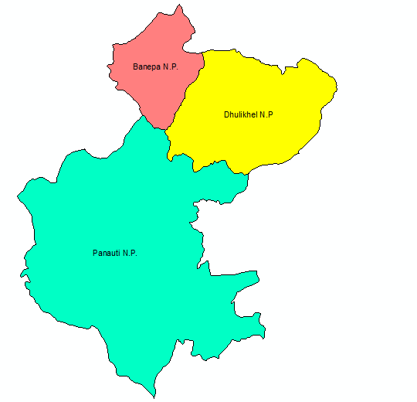
Chorochromatic maps
Also called Mosaic maps
Greek words
Choros = Area; Chroma= Color
Shows nominal values for area through different colors
The map readers get impression of nominal, qualitative differences
This type of map can be prepared easily by using different colors or black and white pattern

Slide 21
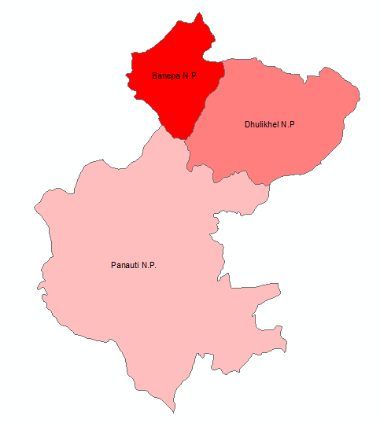
Choropleth maps
Greek words
choros= area Plethos=Value
Ordinal, interval, relative ratio data in aerial unit can be represented
Values that are used to represent area
The values are calculated for the areas and expressed as a stepped surface, showing a series of discrete values.
As these values are represented through area symbols they can only be relative values.
Generally the darker the grey values, the more intense or the higher the densities of the phenomenon.
Eg: population densities per districts,

Slide 22
Isoline maps
Continuous data (usually at interval or ratio
level) are displayed by lines connecting points
with equal, representative values in the data set
E.g.: contours : equal elevation
isotherms : equal temperature
isochrones : equal (travelling) time

Slide 23
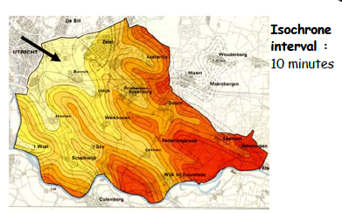
Isopleths maps
Combination of a choropleth and an Isoline map, in which the isolines form the boundaries of the areal units.

Slide 24
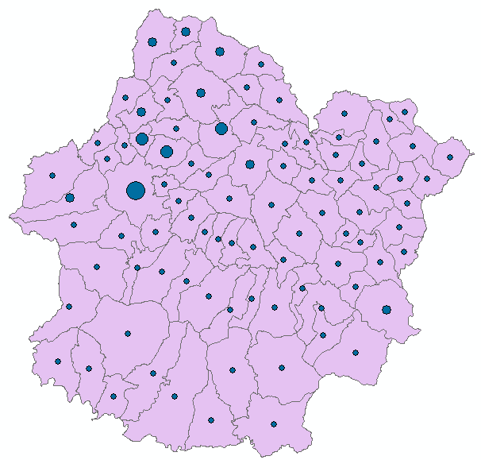
Proportional point symbol map

Slide 25
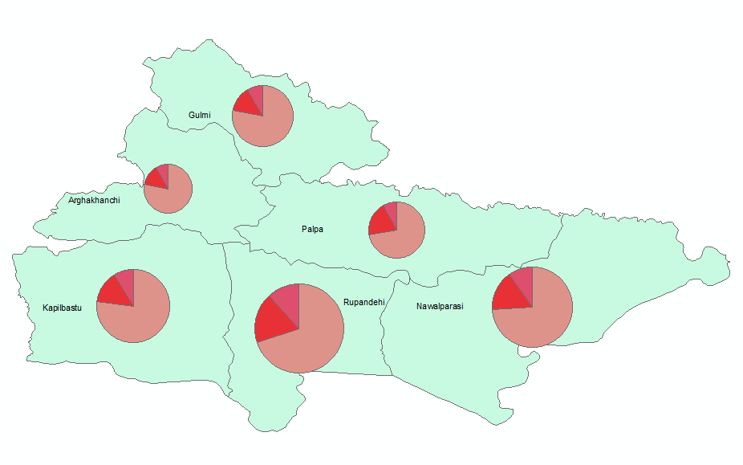
Proportional pie graphs
Circle sizes proportional to total values
Circle sector sizes proportional to corresponding parts of the total

Slide 26
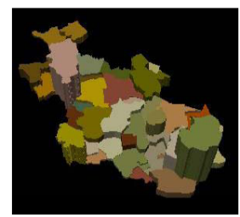
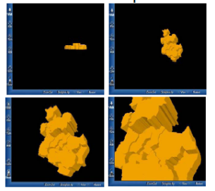
Prism map (stepped statistical surface)
Areas are represented as elevated spatial units (2.5 / 3D) or prisms
Elevation is proportional to the data values: absolute ratio data, aggregated over areas

Slide 27
Flowline map
thematic map type in which directions and/or routes of movement are represented by lines / arrows of varying widths
the width of each line / arrow is proportional to the statistical value of the movement along it (e.g. number of vehicles, volume of freight, monetary value of trade)
application of the visual variable size to represent absolute ratio data

Slide 28
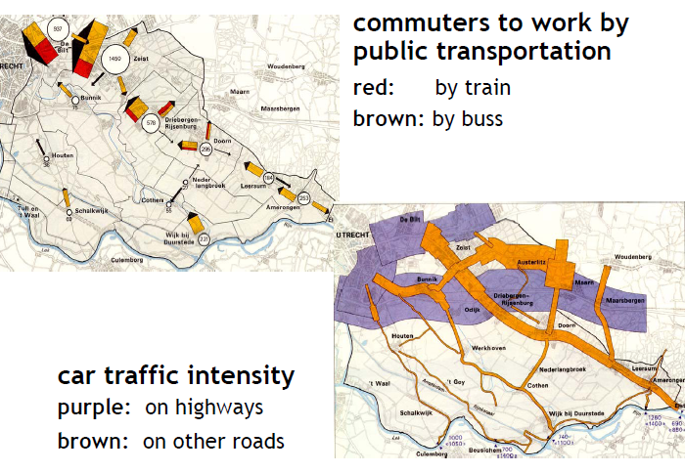
Flowline map

Slide 29
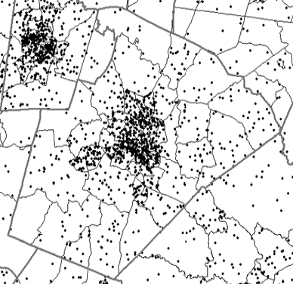
Dot density maps
Shows the actual distribution.

Slide 30
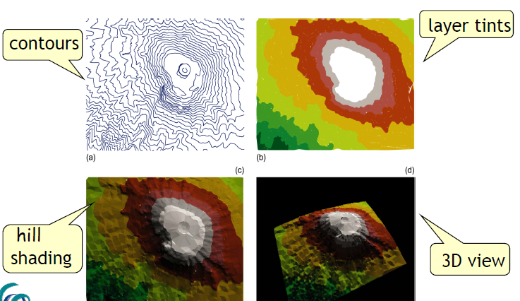
3D map visualization

Slide 31
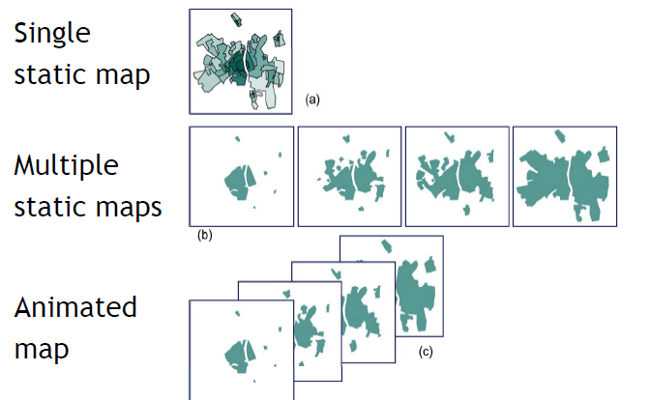
Time Mapping

Slide 32
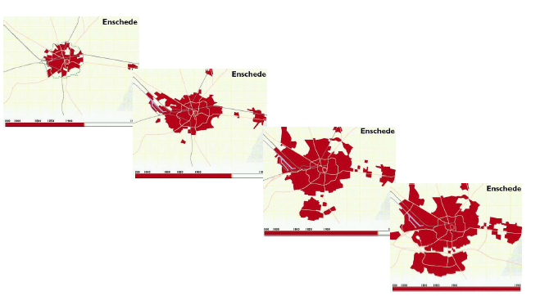
Urban Growth mapping

Slide 33
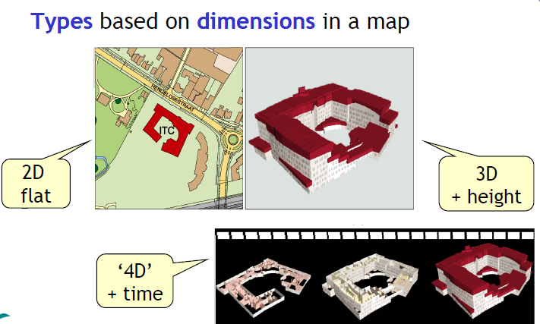
2D, 3D & 4D Mapping

Slide 34
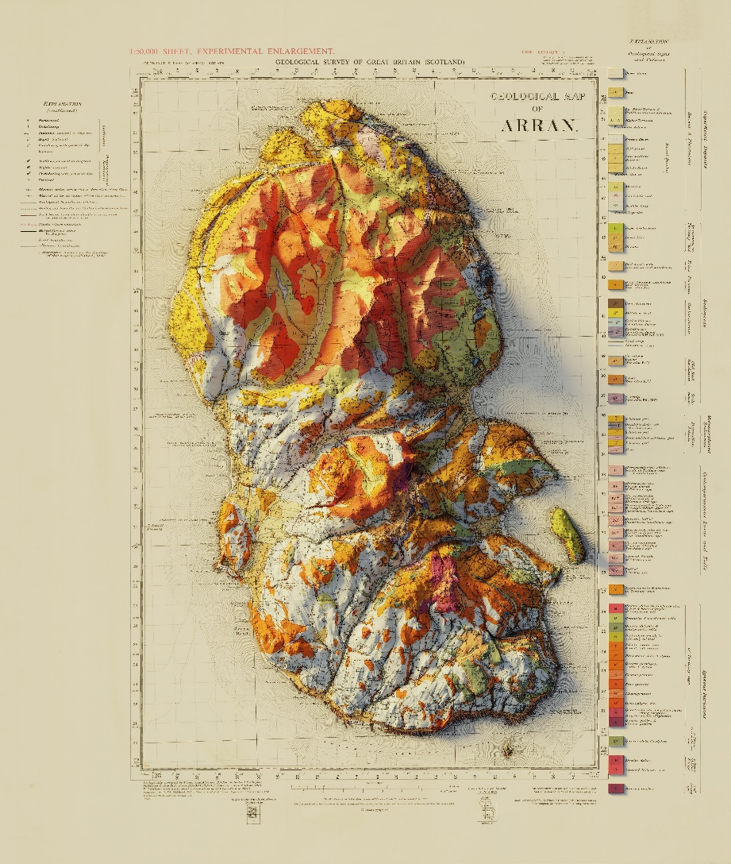
3D maps with hill shading

Slide 35
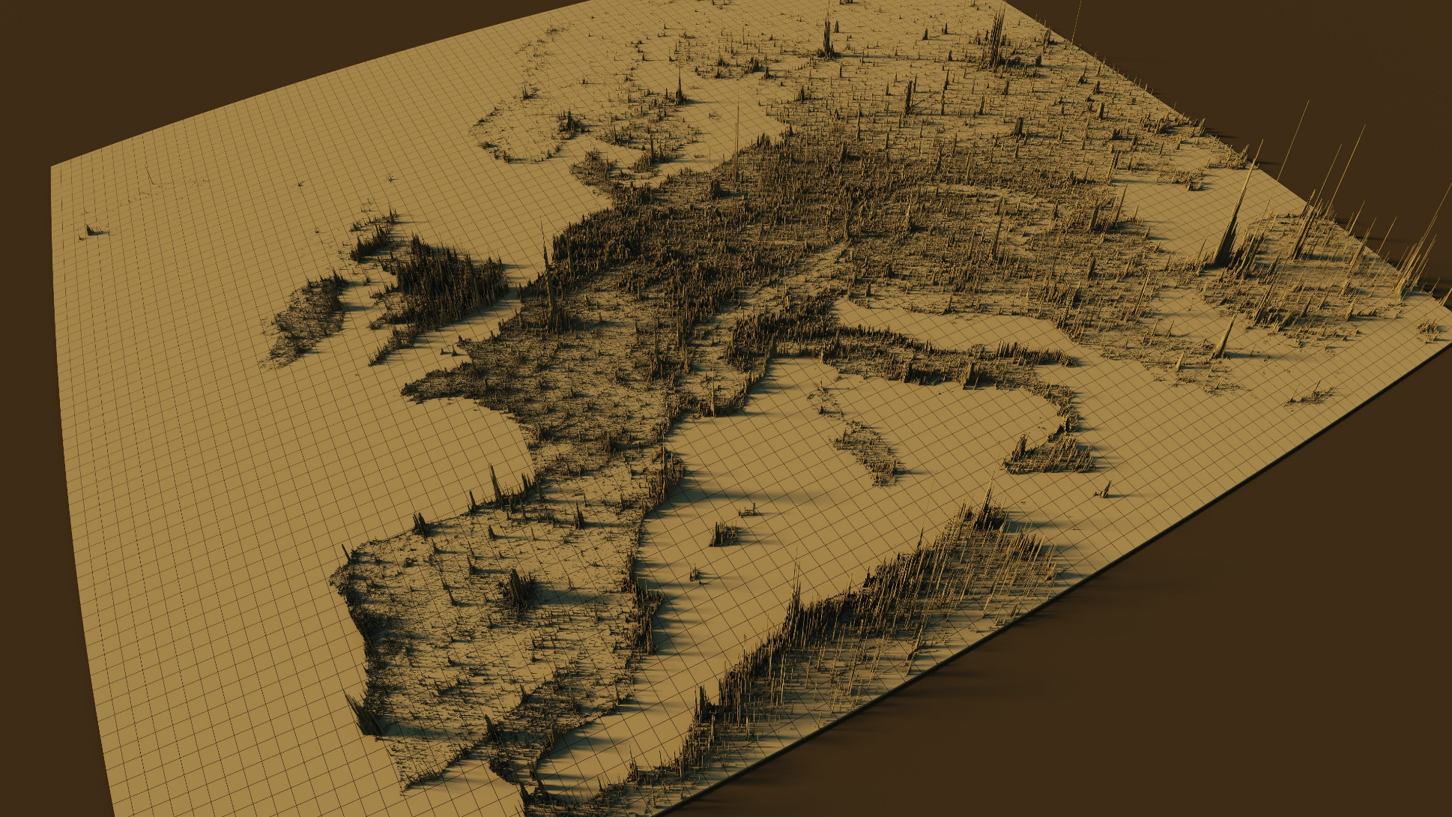
Extrusion Maps

Slide 36
Map Layout

Slide 37
Map Layout
Map layout deals with the arrangements and composition of map elements such as Map body, Map Title, Map Scale, Legend, North arrow, Bibliographic information etc.
Major concerns with layout should have a clear focus to a map body, rest of the part to put in the good order and should look balance as well.
Map layout Tools are available in ArcGIS

Slide 38
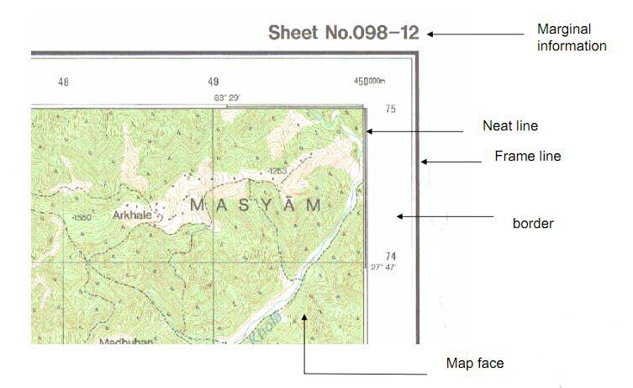
Basic Map Elements
The following are the basic elements of a map;
Map Title ,
Map Scale,
Legend
North arrow
Bibliographic information
Graticule /Grid:
Border Line and Neat lines
Map body
Place names and labeling
These all elements work together to bring spatial information to the map reader.

Slide 39
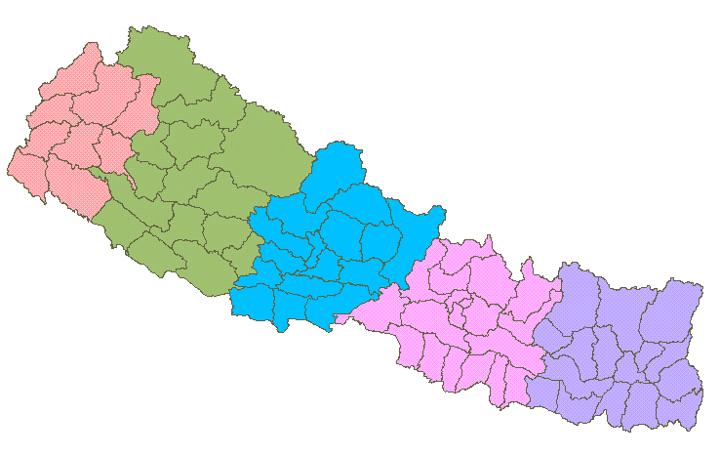
Basic Map Elements
Map Scale Representative Fraction
Neat line
Border
Title
North Arrow
The Development regions of Nepal
Scale 1: 500, 000
Map body
Legend
Central Development region.
Map Index
A B
Inset
Bibliographic information
0
1
2
3
4
This map is produced in 1995 by Survey Department, Nepal
hundreds of
Modified Universal Transverse Mercator Projection
kilometers
Map Scale Graphical Scale
Map Projection

Slide 40
Marginal Information
Additional information to use map properly
Map title
Sheet No
How and when the map was made
Statement of scale and scale line
Legend
Contour interval
Sheet index
Declination Figure
Sheet history
Copy Rights etc

Slide 41
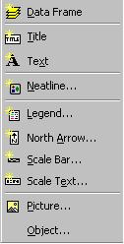
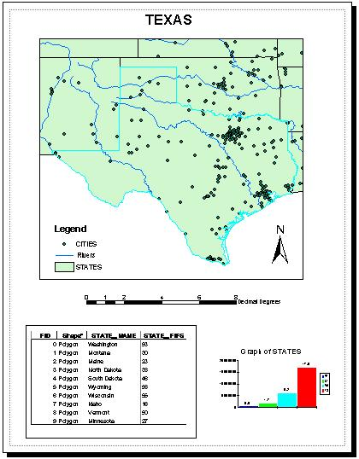
Layouts
Layouts are used to format the final map showing one or more data frames
Layout Title
Data Frame
North Arrow
Legend
Scale Bar
To insert these objects in a layout, use the Insert menu on the ArcMap document.
Chart
Table

Slide 42

Create a map with map elements in ArcMap for the major rivers of Nepal. Add other layers as necessary.

Slide 43
End of Session

